Slide 1




Python Programming
26-Nov-2018
Crash Course Workshop
behzadim
mariebehzadi
mariebehzadi

Slide 2
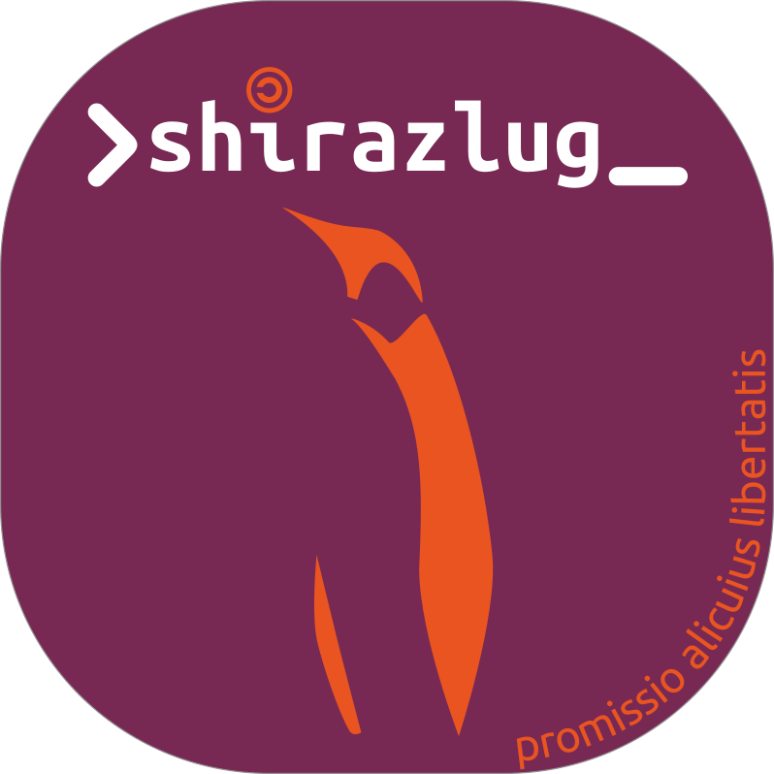
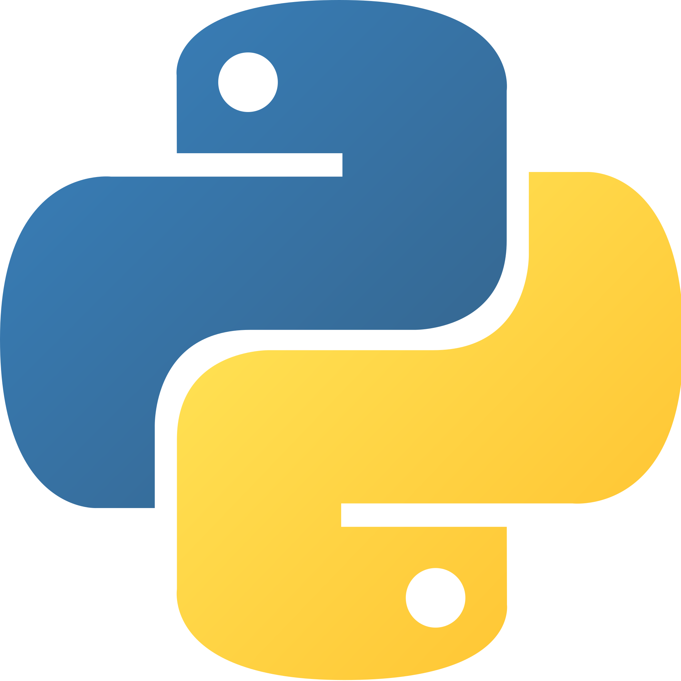
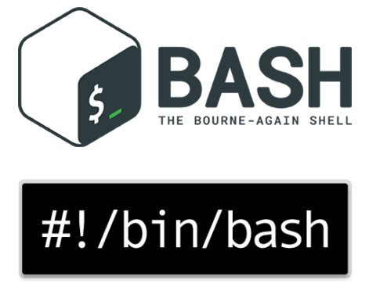
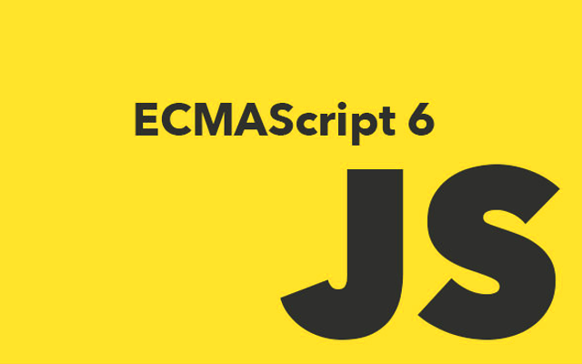

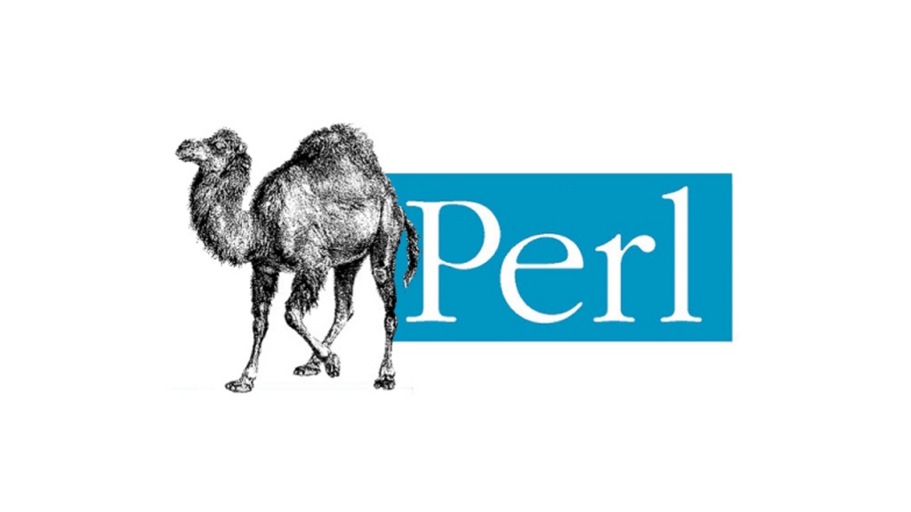
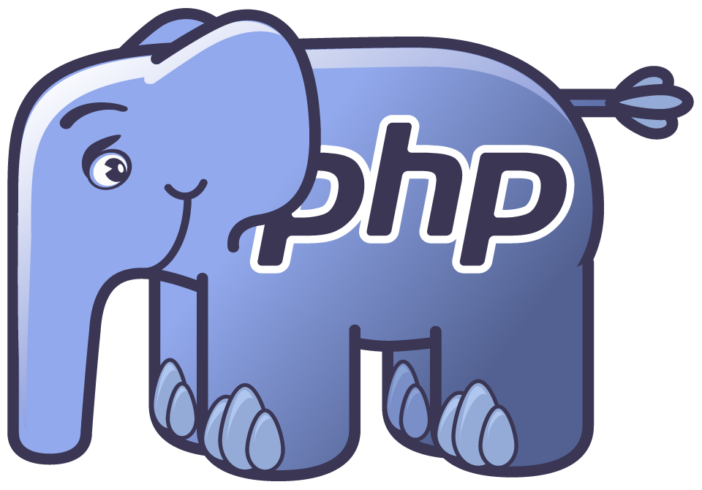
Scripting Language
What is Scripting Language?
Interpreted Programs vs Compiled Programs
#!

Slide 3
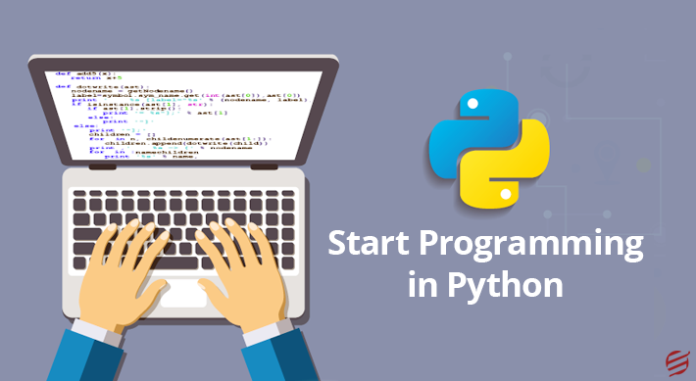
What is Python?
Created in 1990 by Guido van Rossum
Rossum was BDFL until 2018
Origin name from British comedy group Monty Python
An important goal of Python's developers is keeping it fun to use
Interpreted high-level programming language
General-purpose language
Paradigm
  Object-oriented
  Imperative
  Functional
  Procedural
  Reflective

Slide 4
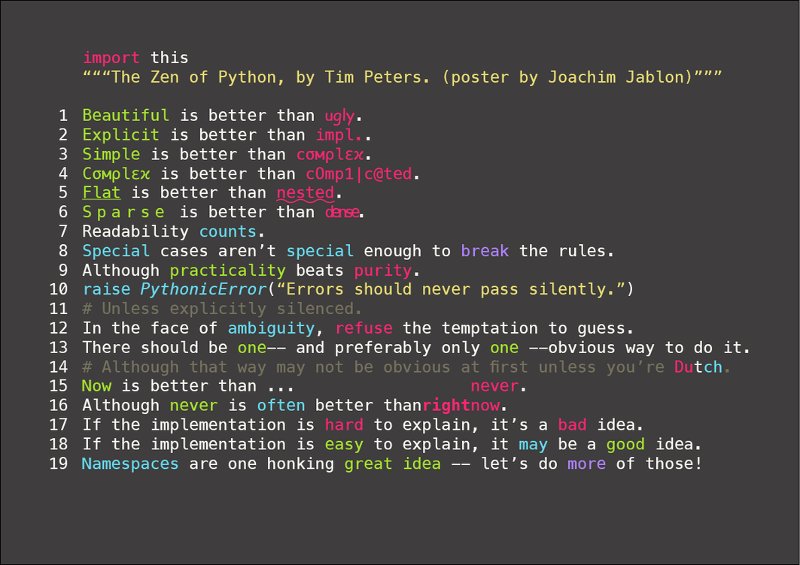
Zen of Python

Slide 5
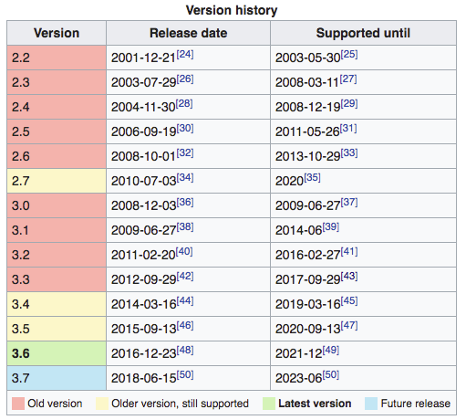
Available Versions

Slide 6
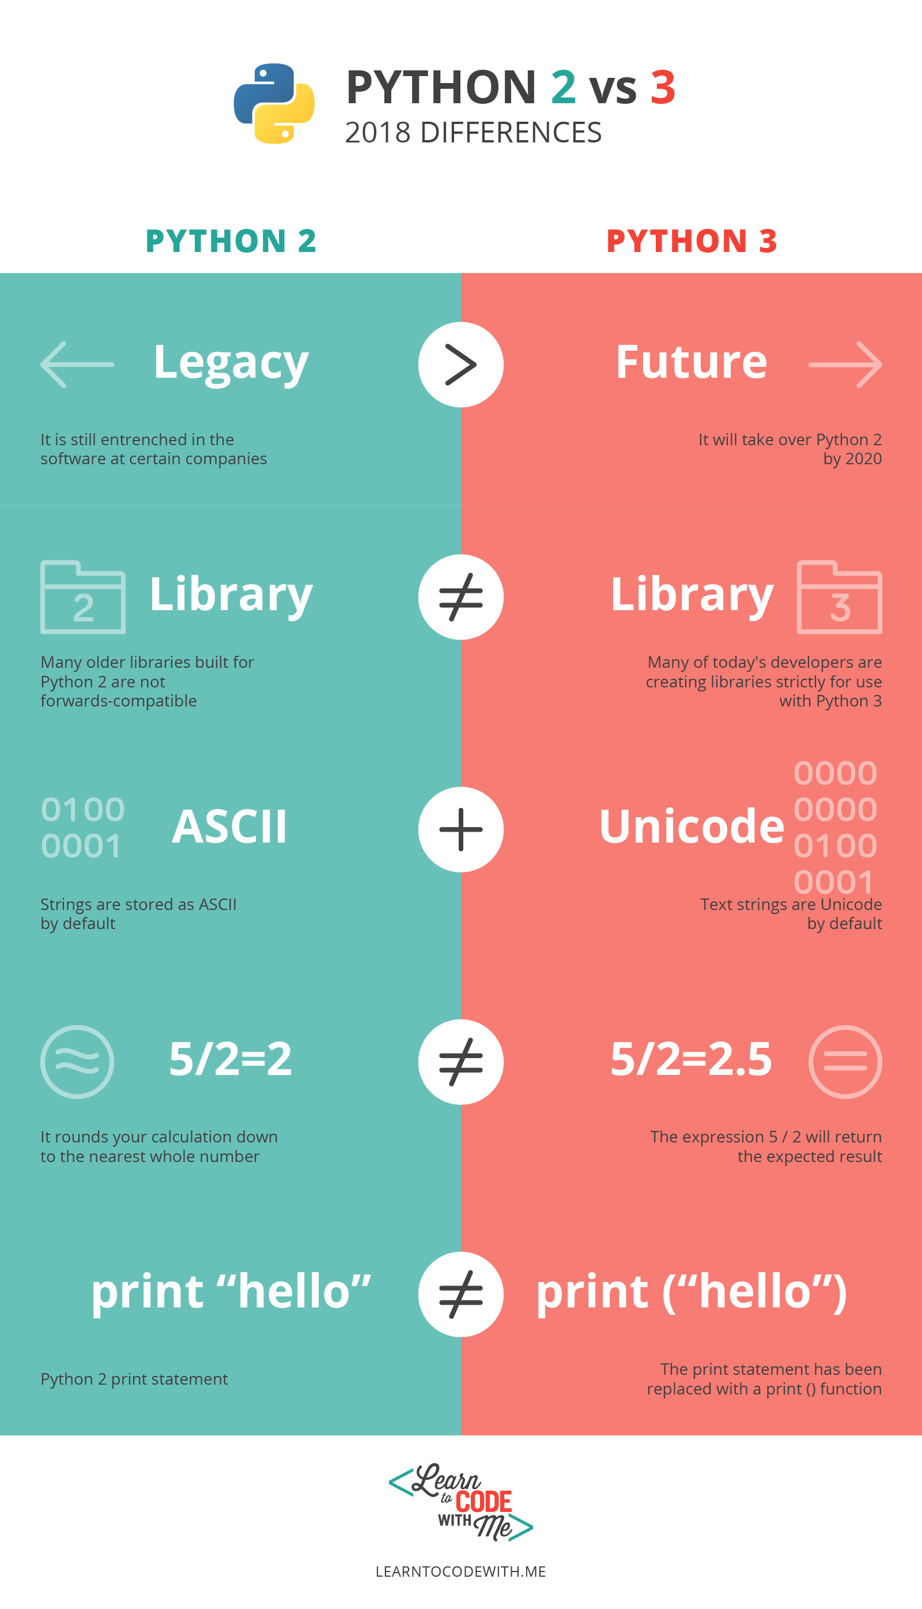

Python 2.7
2016 → 71.9%
2017 → 63.7%

Slide 7
Why Python?
Designed to be easy to learn and master
Readable and Maintainable Code
Multiple Programming Paradigms
Robust Standard Library
Extensive Support Libraries
Compatible with Major Platforms and Systems
Many Open Source Frameworks and Tools
General Purpose Programming Language
Adopt Test Driven Development
Lots of 3rd Party Tools
Active Open-Source Community

Slide 8
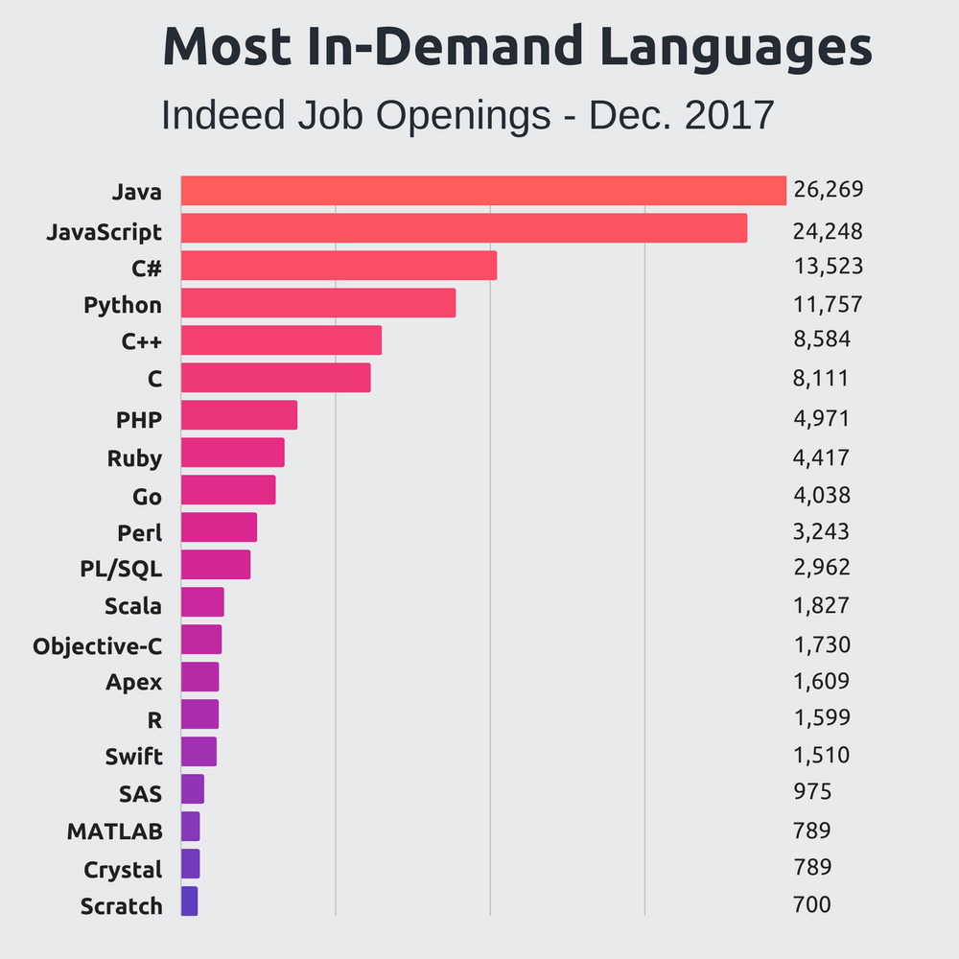
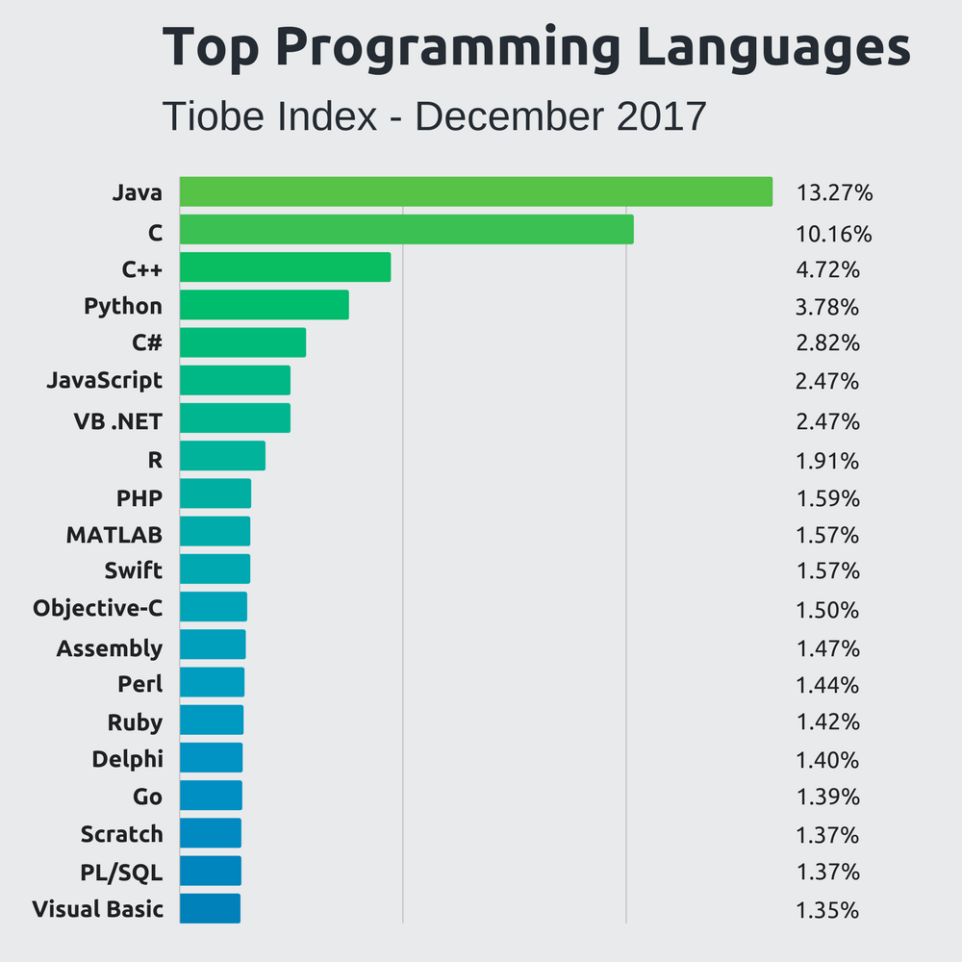
Popularity

Slide 9
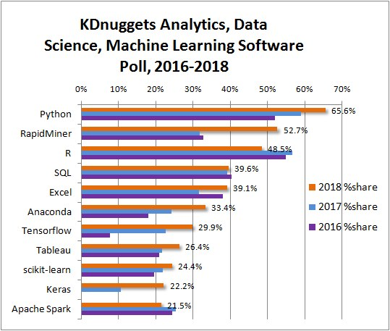
Popularity

Slide 10

Productivity
Reduced Development Time
  Code is 2-10x shorter than C, C++, Java
Improved Program Maintenance
  High Readability
Less Training
  Easy to Learn

Slide 11
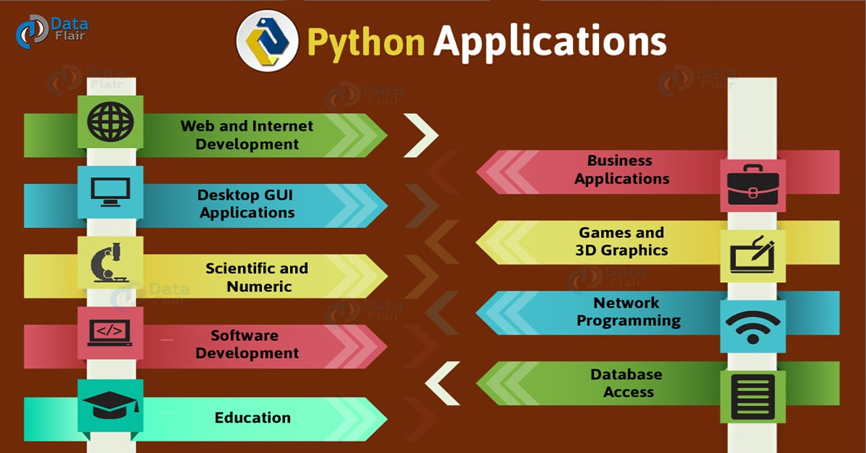

Slide 12
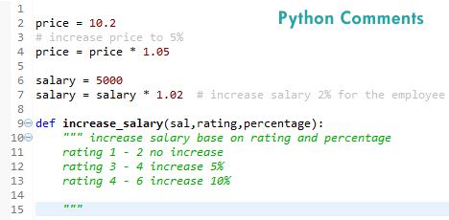
Python Basics (Comments)

Slide 13
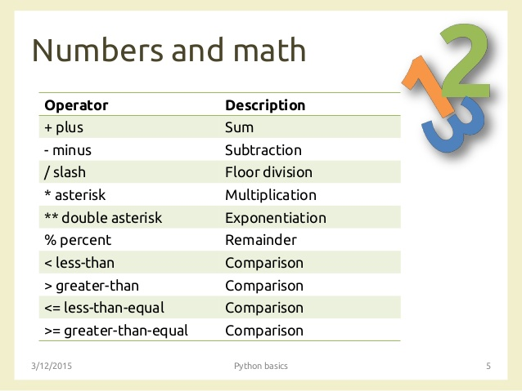
Python Basics (Math Operations)

Slide 14
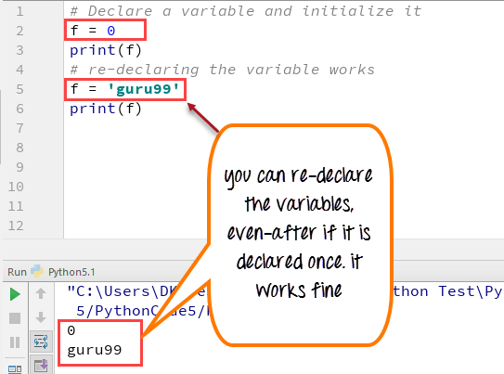
Python Basics (Variable and Types)

Slide 15
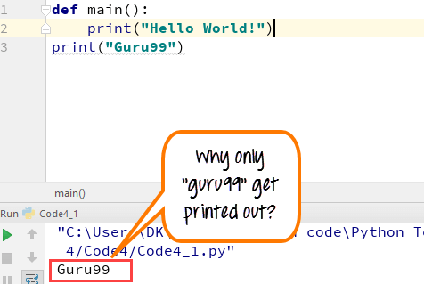
Python Basics (Blocks)

Slide 16
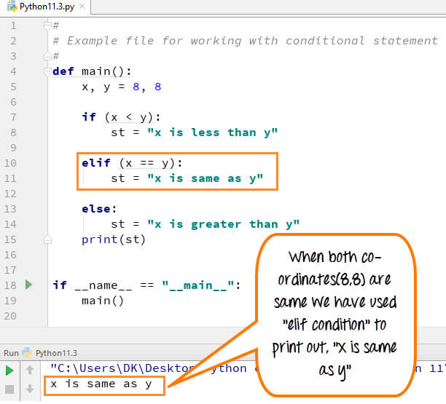
Python Basics (Conditions)

Slide 17
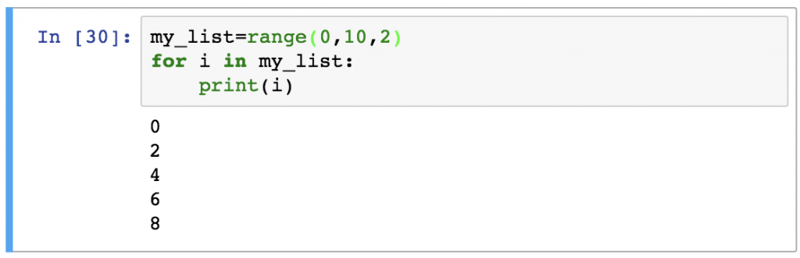
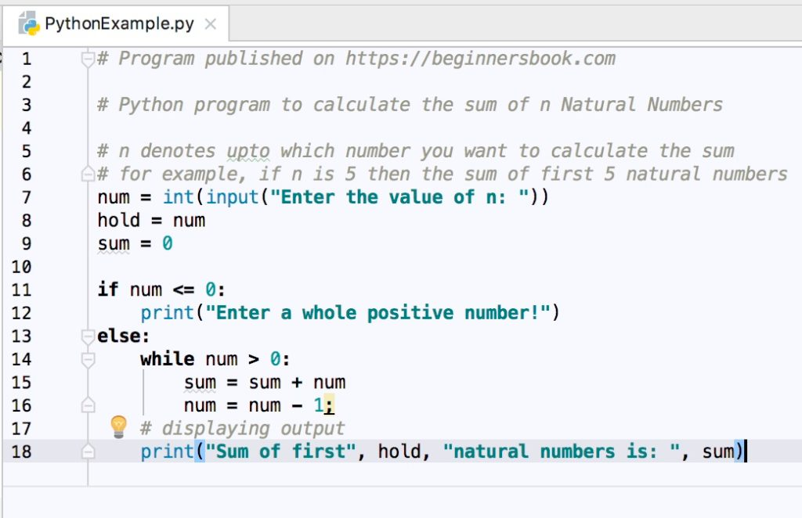
Python Basics (Loops)

Slide 18
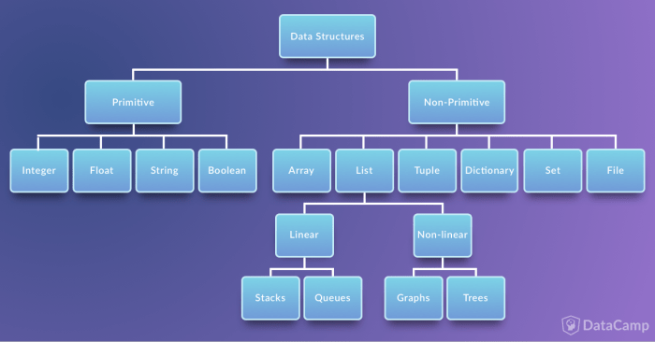
Python Basics (Data Structures)

Slide 19
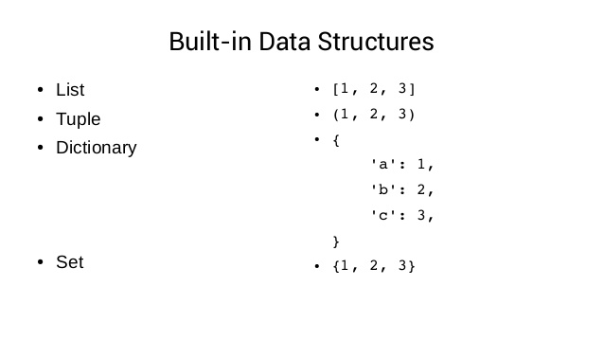
Python Basics (Data Structures)

Slide 20
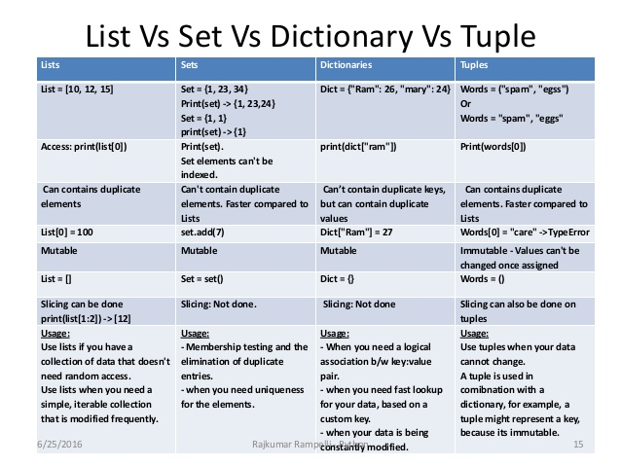
Python Basics (Data Structures)

Slide 21
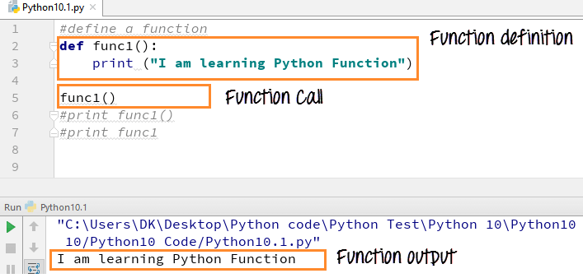
More Details (Functions)

Slide 22
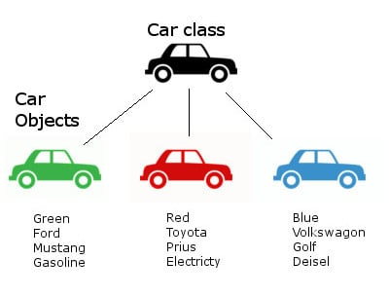
More Details (Class)

Slide 23
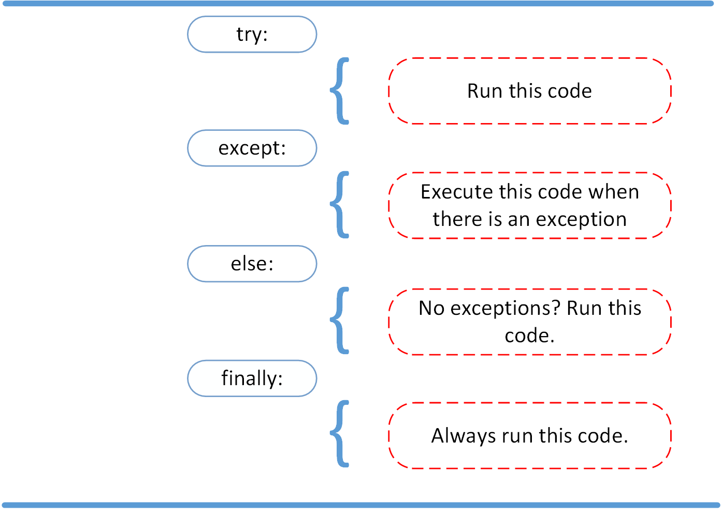
More Details (Exception Handling)

Slide 24


More Details (Module)
logically organize your Python code
Grouping related code → easy, high readability
Simply, a module is a file consisting of Python code
A module can define functions, classes and variables.
A module can also include runnable code.

Slide 25
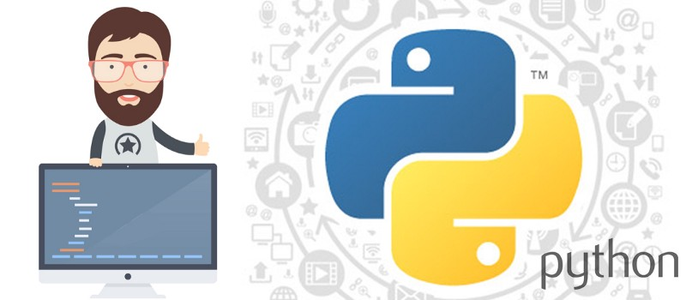
The Python Standard Library
Python comes standard with a set of modules, known as the “standard library”
Incredibly rich and diverse functionality available from the standard library
All common internet protocols, sockets, CGI, OS services, GUI services (via Tcl/Tk), database, Berkeley style databases, calendar, Python parser, file globbing/searching, debugger, profiler, threading and synchronisation, persistency, etc
https://docs.python.org/3/library/

Slide 26

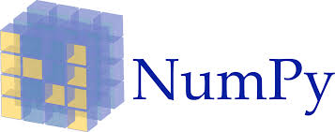


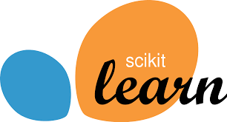

3rd Party Libraries
https://matplotlib.org/
http://www.numpy.org/
https://www.scipy.org/
https://pandas.pydata.org/
https://scikit-learn.org/
https://pypi.org/project/opencv-python/

Slide 27
Numpy
Numerical Python
Why NumPy?
Designed for scientific computing
Open-Source
ndarray is the core object
Advanced functions to work with arrays
Universal Functions (ufunc)
Basic Linear Algebra
Basic Statistical Operations
Random Simulation
discrete Fourier transforms
mathematical, logical, shape manipulation
Numeric + Numarray ~ NumPy

Slide 28
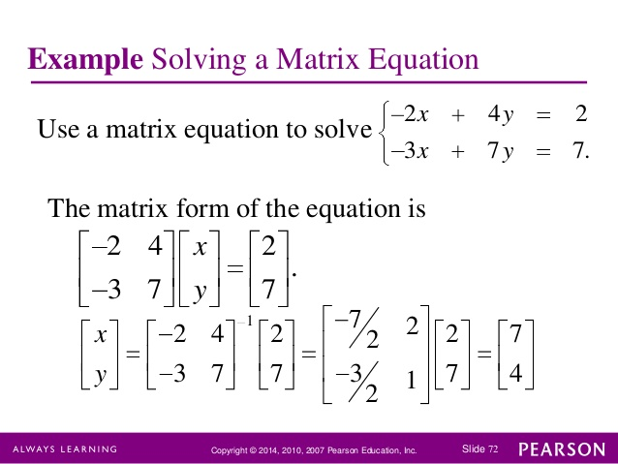
Numpy / Linear Algebra

Slide 29
Pandas
data manipulation and analysis
data structures and operations for manipulating numerical tables and time series
The name is derived from the term "panel data"
DataFrame is the Core Object
Suitable for Data Wrangling
Open-Source

Slide 30
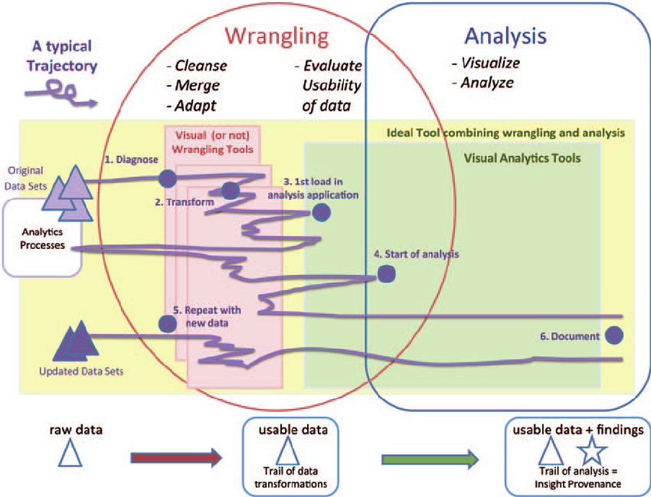
Pandas (Data Wrangling)

Slide 31
scikit-learn
free software machine learning library for the Python
Used in data mining and data analysis
Built on NumPy, SciPy, and matplotlib
Open-Source
classification, regression and clustering algorithms
  support vector machines
  random forests
  gradient boosting
  k-means
  DBSCAN

Slide 32
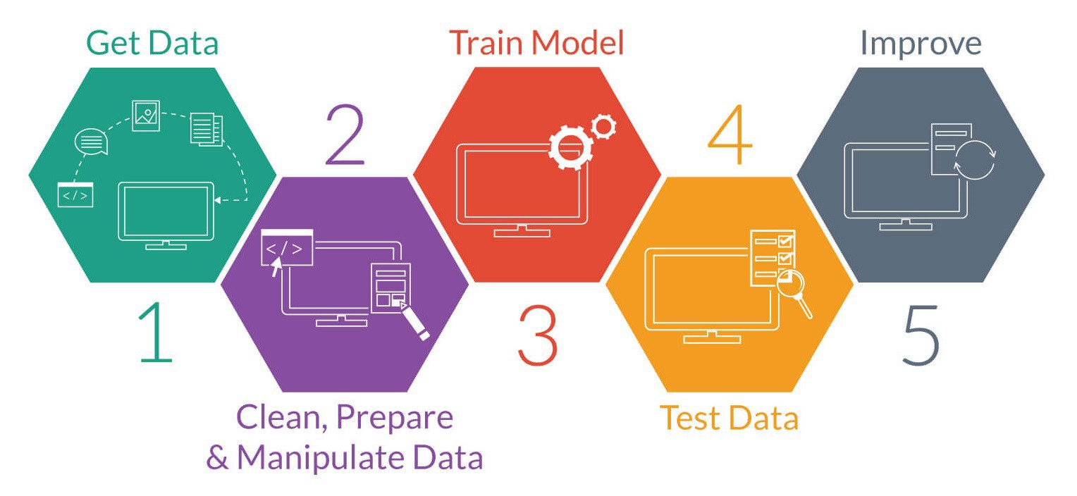
scikit-learn (Data Modeling & Prediction)

Slide 33



